Slide 1

Online ticket booking
smriti

Slide 2
KPI : Key Performance Indicators
Time to Market
Dev-Prod Parity
CI/CD
Security
Code quality
SLA %
Incident ticket
Innovation
Backing Services
Concurrency

Slide 3
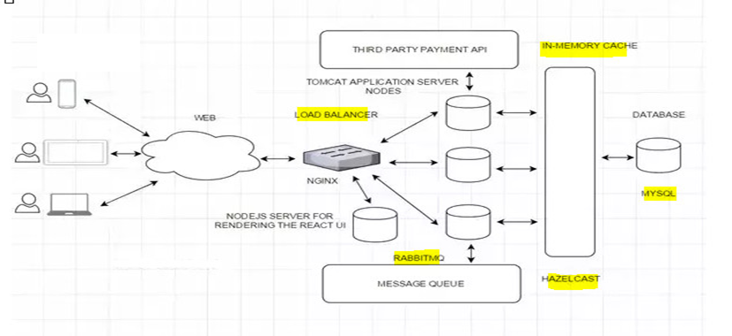
High Level diagram

Slide 4
Technology considerations
Cloud- Azure
UI: Angular
Framework: Spring Boot, Rest Web Services
Security: Spring Security
Database: MySQL
Server: Tomcat
Caching: In memory cache Hazelcast/ Memcache
Notifications: RabbitMQ. A Distributed message queue for push notifications.
Payment API: Popular ones are Paypal, Stripe, Square
Deployment: Jenkins-> Docker-> Kubernetes
Code repository: Git
Logging: Log4J
Log Management: Logstash, ELK Stack
Load balancer: Nginx

Slide 5
Functional / Nonfunctional requirements
Non-Functional Requirements:
The system would need to be highly concurrent. There will be multiple booking requests for the same seat at any particular point in time. The service should handle this gracefully and fairly.
The core thing of the service is ticket booking which means financial transactions. This means that the system should be secure and the database ACID compliant.
The system will not handle partial ticket orders. Either user gets all the tickets they want, or they get nothing.
We can assume that traffic would spike on popular/much-awaited movie releases, and the seats fill up pretty fast.
The system should be scalable, highly available to cope up with the surge in traffic.

Slide 6
Functional / Nonfunctional requirements
Functional Requirements:
Our ticket booking service should be able to list down different cities where its affiliate cinemas are located.
Once the user selects the city, the service should display the movies released in that particular city.
Once the user selects the movie, the service should display the cinemas running that movie and its available shows.
The user should be able to select the show at a particular cinema and book their tickets.
The service should be able to show the user the seating arrangement of the cinema hall and the user should be able to select multiple seats according to their preference.
The user should be able to distinguish available seats from the booked ones.
Users should be able to put a hold on the seats for five minutes before they make a payment to finalize the booking.
The user should be able to wait if there is a chance that seats might become available – e.g. when holds by other users expire.
Waiting customers should be serviced fairly in a first come first serve manner.

